Slide 1
Computer Networks
Dr. Basil Elmasri
b.elmasri@gold.ac.uk

Slide 2
Outline
Computer networking : a top-down approach / James F. Kurose, Keith W. Ross. — 6th edition
Ways of communication
Connectivity – links
Topology and devices – nodes
Interconnectivity
Area networks
Switching and multiplexing – packet and circuit switching
Reliability and loss tolerance. Types of delay, and packet loss
Internet layers and Architecture, headers. Encapsulation.

Slide 3
Basics
Unicast: source to one destination
Broadcast: source to all destinations
Multicast: source to subset destination
Physical media:
Twisted-Pair Copper Wire
Coaxial Cable
Fiber Optics
Radio Channels, and satellite communications
Topologies: Star, bus, token ring, wireless

Slide 4
Packet Switching vs Circuit Switching
In circuit switching, link, transmission rate, are reserved with fixed values for communication between end systems. E.g. landline telephones
In Packet Switching, long messages are broken down into smaller chunks of data known as packets.
Store-and-forward transmission for the packets within the network nodes, e.g. routers, switches. No fixed link or resources.
Each node has a buffer, stores coming packets, then forward to destinations. E.g. the internet.

Slide 5
The internet architecture
Delay, Loss, and Throughput issues in Packet-Switched Networks
Layered Architecture of the internet, logically separate functions. Each layer may have different responsibility than other layers. For example; guaranteed delivery, routing, addressing.
Encapsulation: a chuck of an application data is appended with extra information at each layer, called headers, and footers

Slide 6
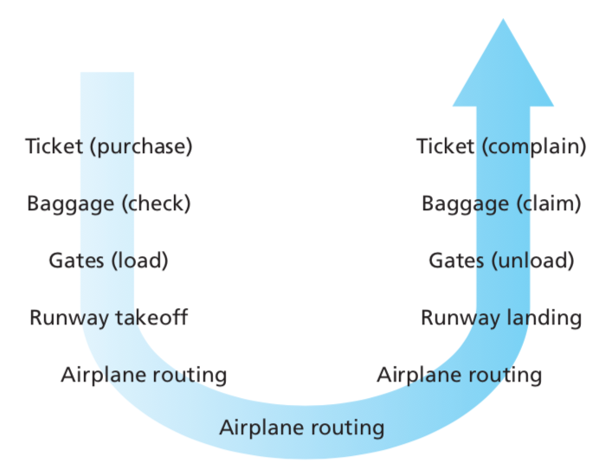
Example on layering, travel by areoplanes

Slide 7
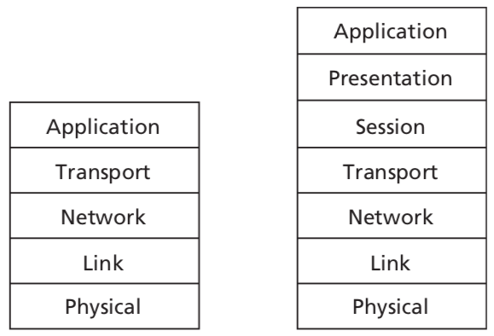
Internet layers, IOS reference model

Slide 8
Networked applications architecture
Client-server architecture: an always-on host, or process, running all time, called the server, which services requests from many other hosts, called clients.
Server usually has a fixed, well-known address; IP address.
Examples: web servers, mail servers.
Peer-to-peer (P2P): minimal, or no dedicated servers
Application direct communication between, nearly equal, pairs of connected hosts, called peers.
Examples: file sharing; torrents, internet telephony.

Slide 9
Application layer
Examples on services and protocols
Services | Protocols
Web | HTTP
Naming system | DNS
E-mail | SMTP
File transfer | FTP
Internet telephony | SIP and RTP
Exchanging information | SOAP

Slide 10
HyperText Transfer Protocol (HTTP)
Web page, a document consists of objects.
An object is a file; such as an HTML file, an image, video clip.
Each object is addressable by a single URL. Web pages consist of a base HTML file.
Web browsers implement the client side of HTTP. Web servers, which implement the server side of HTTP, hosts Web objects
Servers include Apache and Microsoft Internet Information Server. (IIS)
Versions: HTTP 1.0, HTTP 1.1, HTTP 2.0 (SPDY)
Messages: request and response messages

Slide 11
HTTP Message Format
The types of messages exchanged, for example, request messages and response messages
The syntax of the various message types, such as the fields in the message and how the fields are described
The semantics of the fields, that is, the meaning of the information in the fields
Rules for determining when and how a process sends messages and responds to messages

Slide 12
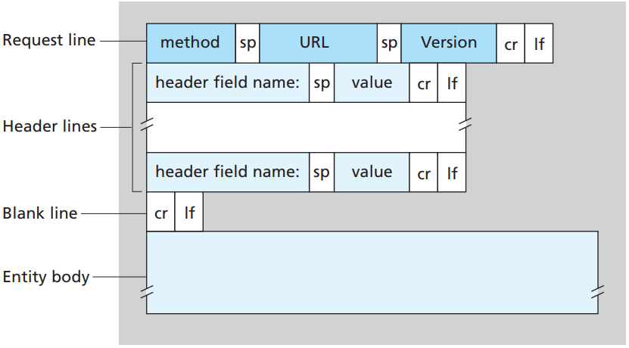
HTTP Request Message Format

Slide 13
HTTP Request explained
sp: space, cr: carriage return, and lf: line feed.
Methods: GET, POST, HEAD, PUT, DELETE, TRACE, OPTIONS, CONNECT, and PATCH.
URL: object location on the host
Header lines include different parameters and values
Host: host name, the server name
HTTP Connection type
Client’s browsers, e.g. Mozilla, Chrome, etc..

Slide 14
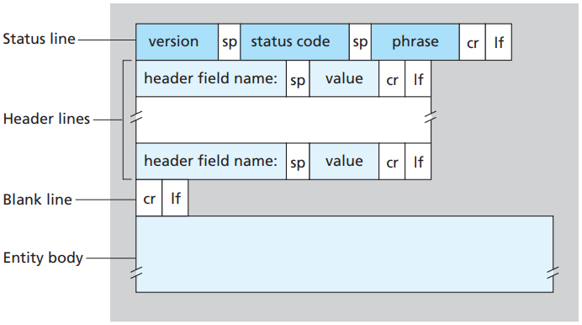
HTTP Response Message

Slide 15
HTTP Response explained
Status codes and phrases types:
1xx Informational response
2xx Success
3xx Redirection
4xx Client errors
5xx Server errors
Examples: 200 OK, 404 Not Found, 500 Internal Server Error, 503 Service Unavailable; server is overloaded or down, 505 HTTP Version Not Supported
Header lines: Date, content-Length, Content-Type, Server

Slide 16
Domain Name System (DNS)
Hosts are identified by URLs and IP addresses
DNS is like the Internet’s Directory Service. It translates user-supplied hostnames to IP addresses, in a hierarchal way.
Example: hostname gold.ac.uk, IP address 159.100.136.49
.uk level domain is resolved, then .ac.uk, then gold.ac.uk
DNS is used in various internet applications, web, email, file download...etc.
CMD command: “nslookup” followed by hostname or address

Slide 17
Transport Layer
End to end delivery guarantee.
Connection-Oriented and Connectionless Communication
Same Order Delivery
Flow Control, end systems capabilities
Traffic Control, for the network and its congestion
Multiplexing: the use of different and simultaneous applications over a network, e.g. different internet browsers are opened on the same computer.
User Datagram Protocol (UDP), an unreliable, connectionless service, usually for non-delay tolerant applications.
Transmission Control Protocol (TCP) connection-oriented, reliable.

Slide 18
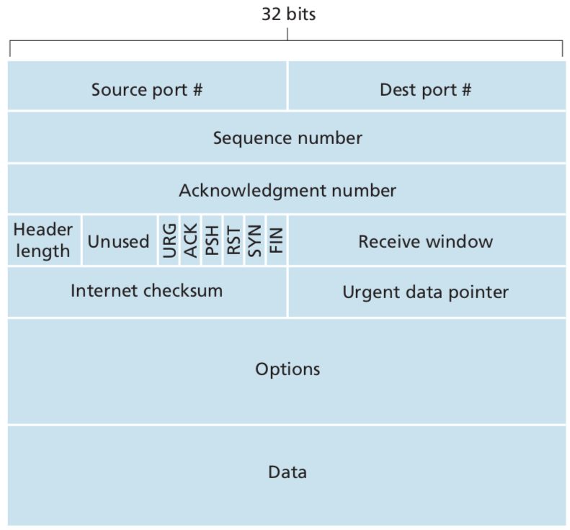
Transmission Control Protocol (TCP)
Fields are NOT textual like HTTP
They are set in binary values

Slide 19
TCP header explained (I)
Source and destination port numbers, used for multiplexing/demultiplexing data from/to upper-layer applications
Sequence number field and acknowledgment number fields are used by the TCP sender and receiver in implementing a reliable data transfer. A sent TCP segment has to be acknowledged
Receive window field is used for flow control, to indicate the number of bytes that a receiver is willing to accept.
header length field specifies the length of the TCP header

Slide 20
TCP header explained (II)
The Options field is optional and it is variable-length, it is used for extra information, e.g. when a sender and receiver negotiate the maximum segment size (MSS), or a window scaling factor for use in high-speed networks. A time-stamping option is also defined in some cases.
Usually, the options field is empty, so that the length of the typical TCP header is 20 bytes.
Checksum provides integrity and error detection, to determine whether bits within the segment have been altered.

Slide 21
TCP header explained (III) – flags
Flags, 6 bits.
ACK to indicate that the segment contains an acknowledgment
The RST, SYN, and FIN bits are used for connection setup and teardown, Reset, Synchronisation, and Finish
The PSH bit indicates that the receiver should pass the data to the upper layer immediately.
URG bit is used to indicate that there is data in this segment that the sending-side upper-layer entity has marked as “urgent.”
The location of the last byte of this urgent data is indicated by the 16-bit urgent data pointer field.

Slide 22
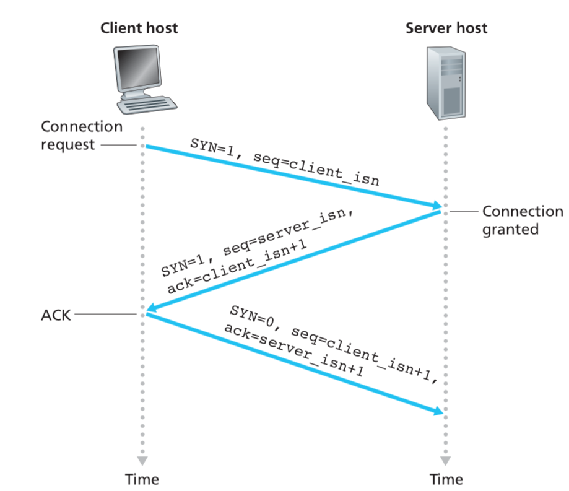
Three-way handshake
Connection establishment
a client wants to initiate a TCP connection
Some flags’ values are set from 0 to 1. SYN, ACK

Slide 23
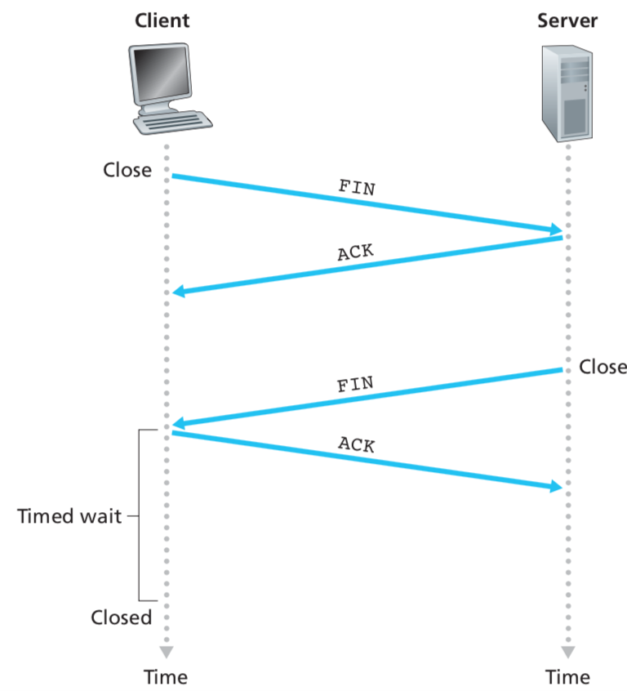
Closing TCP connection FIN flags are set to 1

Slide 24
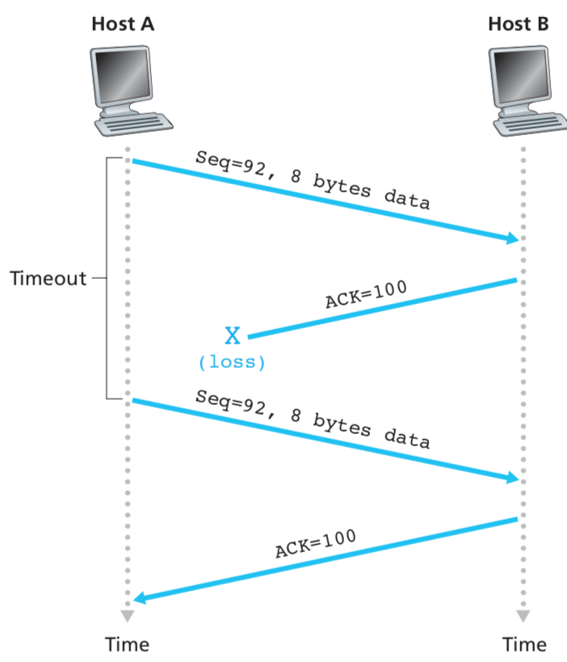
Reliability: retransmission
Data received but acknowledgement got lost

Slide 25
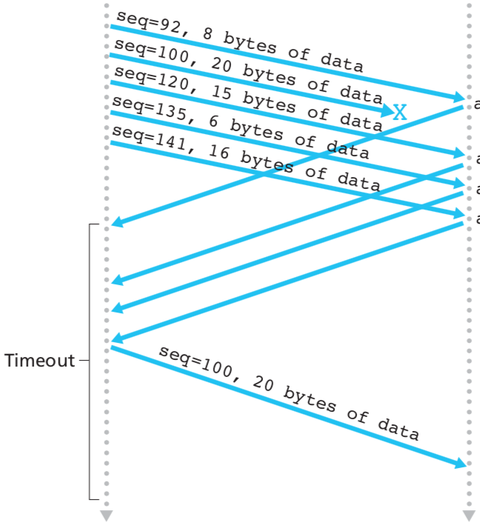
Fast retransmit: retransmitting the missing segment before the segment’s timer expires

Slide 26
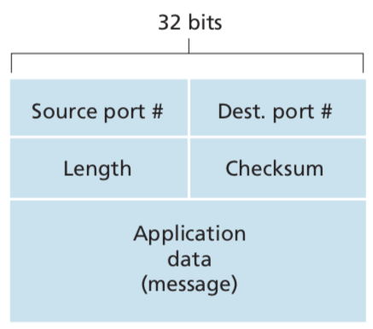
User Datagram Protocol (UDP)
Compare TCP to UDP header

Slide 27
Network Layer
Moving (routing) network-layer packets known as datagrams from one host to another
A transport layer protocol (TCP or UDP) in a source host passes a transport-layer segment and a destination address to the network layer.
Routers in the internet are network layer network nodes
Forwarding packets arrives at a router’s input link, the router must move the packet to the appropriate output link
Routing. The network layer must determine the route or path taken by packets as they flow from a sender to a receiver.
Every router has a forwarding table.

Slide 28
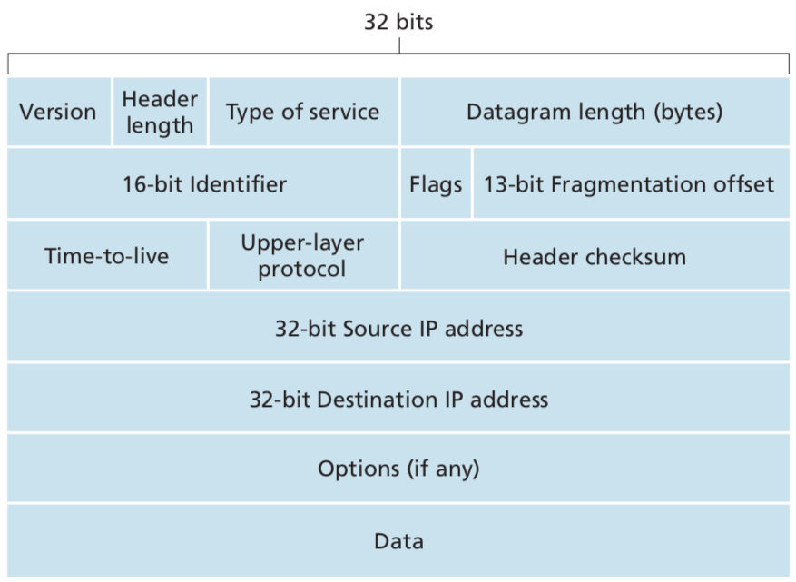
Internet Protocol (IP)
4

Slide 29
IP header explained (I)
Version number: 4 bits, IPv4, IPv6
Header length. to determine where in the IP datagram the data actually begins.
Identifier, flags, fragmentation offset. For IP fragmentation
Time-to-live (TTL): to ensure that IP datagrams do not circulate forever. This field is decremented by one each time the datagram is processed by a router. Once the TTL field reaches 0, the datagram must be dropped.
Upper Layer Protocol. when an IP datagram reaches its final destination. Indicates the specific transport-layer protocol to which the data portion of this IP datagram should be passed. TCP value is 6 UDP’s is 17.

Slide 30
IP header explained (II)
Header checksum. Helps a router in detecting bit errors, and achieve integrity.
Source and destination IP addresses, 32 bit IP addresses
source host usually determines the destination address via a DNS lookup.
Options. This fields is rarely used, to allow an IP header to be extended.
If an IP datagrams do not contain options, so a typical IP datagram is 20-byte header

Slide 31
Other Network layer issues
Routing, how to fill up forwarding tables in the routers?
Routing algorithms and routing protocols.
Distance Vector (DV) algorithm: Routing Information Protocol (RIP)
Link-state routing algorithm: Open Shortest Path First (OSPF)
IP addressing, particularly IPv4
IPv6, differences from IPv4, why it was proposed and developed.
Mobile IP, for wireless mobile network

